Slide 1
Optimal Transport - Image Colorization
DUSSOLLE Antoine
JABEA Christopher
NANTAS Paul
THABET Achraf
Notes:
Adaptive color transfer with relaxed optimal transport - J.Rabin & et alia - (2014)

Slide 2
SOMMAIRE
CONSIDERED ISSUE
1.1 - Optimal Transport in Imaging
1.2 - Color Transfer
2. PROPOSED MODEL
2.1 Problem formulation
2.2 Tackle the issues
2.3 Final problem
3. APPLICATION TO COLOR TRANSFER
3.1 Framework
3.2 Spatio-color clustering
3.3 Color Palette Transfer & Image Synthesis
4. EXPERIMENTS
4.1 Metrics
4.2 Applications
Notes:
2 - Christopher
3 - Antoine
4 Achraf

Slide 3
I- CONSIDERED ISSUE
Notes:
We are going to introduce a paper about the problem of color transfer using optimal transport technique. The main issue of this technique is the sensitivity to noise and outliers.
In addition, this is not suitable for direct application to images without additional post-processing regularization to remove artefacts
The approach of this paper is an extension of their first paper in 2013 named Regularized Discrete Optimal Transport.

Slide 4
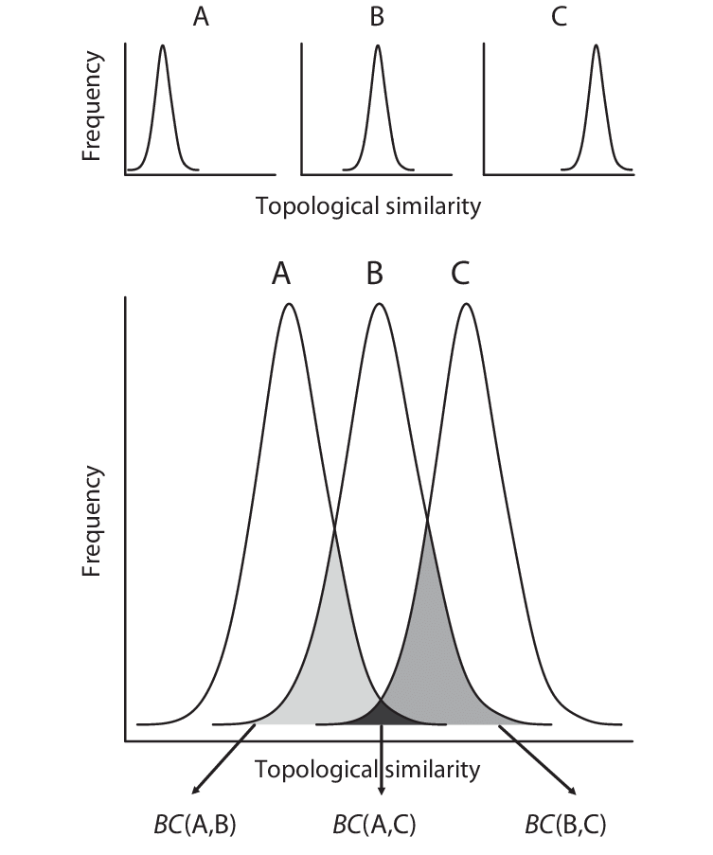
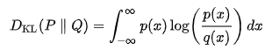
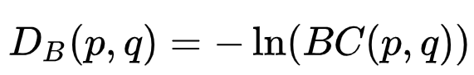
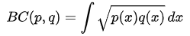
1.1 Optimal Transport in Imaging
Usual distances to compare densities
Bhattacharyya distance
Kullback–Leibler divergence
(Or relative entropy)
Bhattacharyya distance
It is the expectation of the logarithmic difference between the probabilities P and Q, where the expectation is taken using the probabilities P.
Bhattacharyya coefficient
This is an approximate measurement of the amount of overlap between two statistical samples.
https://en.wikipedia.org/wiki/Bhattacharyya_distance
Notes:
A large class of Im. Proc. problems involve probability densities estimated from features. Most distances such as (slides) give accurate estimations of densities similarities.
Bhattacharyya coefficient for continuous probability distributions. This is an approximate measurement of the amount of overlap between two statistical samples.
The Kullback-Leibler divergence is also a statistical distance.
In other words, it is the expectation of the logarithmic difference between the probabilities P and Q, where the expectation is taken using the probabilities P
However, those tools are not adapted when the density nodes are not located spatially at the same place.
Here comes the Optimal Transfer in imaging.

Slide 5
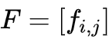
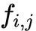
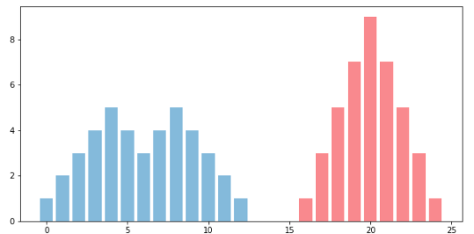
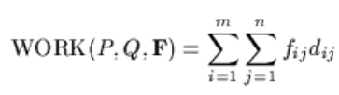
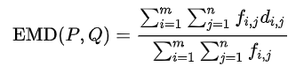
1.1 Optimal Transport in Imaging
OT distance (EMD - Wasserstein metric)
The OT problem consists in estimating the minimal cost of transferring a source distribution into a target one.
We have a signature P with m clusters (p1,..,pm) and a signature Q with n clusters (q1,..,qn).
We want to find a flow with the flow between pi and qj that minimizes the overall cost.
The earth mover's distance is defined as the WORK normalized by the total flow as follows:
Piles of sand with the same mass
https://towardsdatascience.com/image-processing-and-optimal-transport-f707c7296b67
https://en.wikipedia.org/wiki/Earth_mover%27s_distance
Notes:
Here comes the Optimal Transfer in imaging.
It has been widely used in the last decades for multiple image processing issues.
The OT distance (known as the Earth mover distance) has been shown to produce state of the art results for the comparison of discrete statistical descriptors.
Imagine we have a pile of sand with n grains of sand and want to build a sandcastle out of it. We might wonder how much effort it will take. So we start with calculating the distance that each grain of sand needs to be moved . For example, we might have a pile of sand in the form of the blue mass in Figure 3 and want to put it into the shape of the red mass.

Slide 6
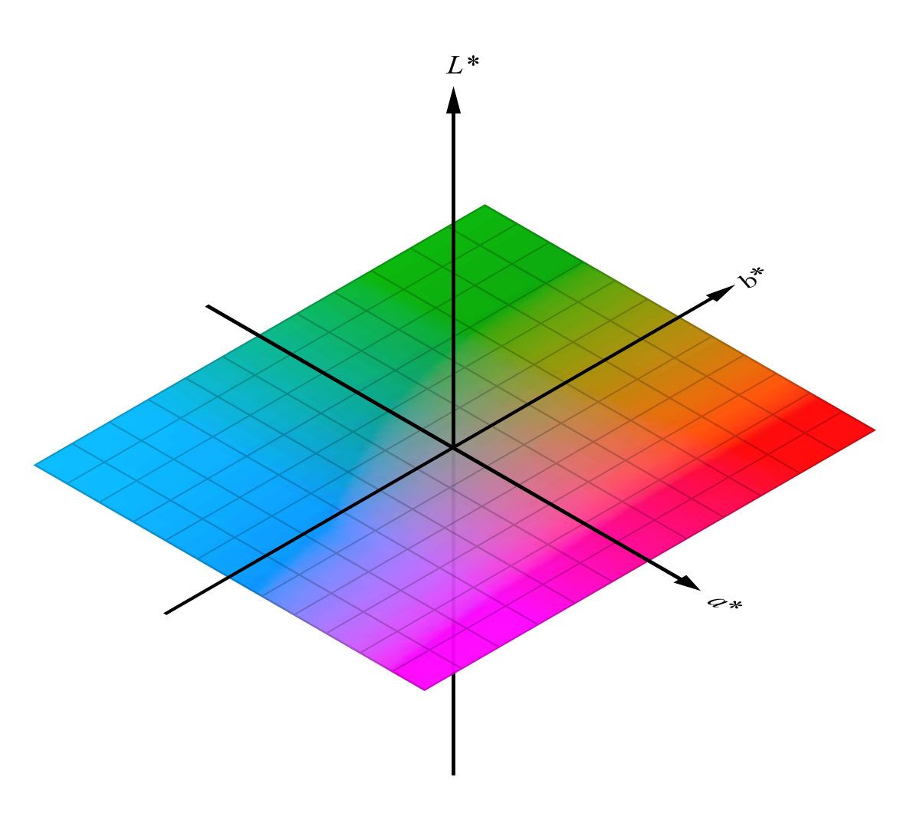
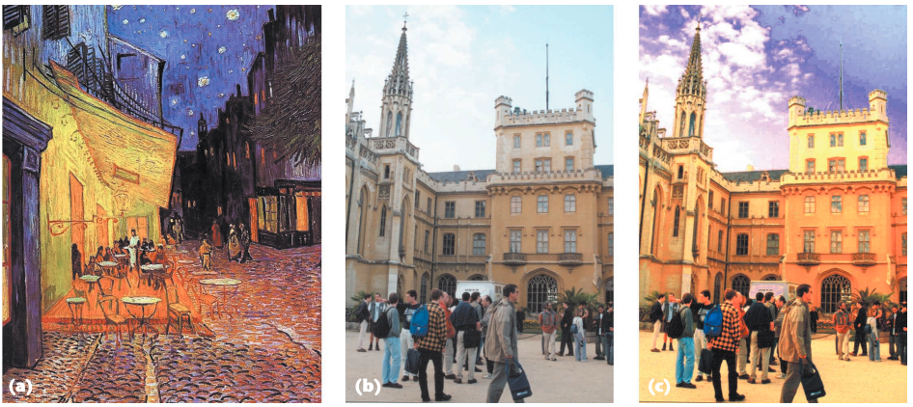
1.2 Color Transfer
Color Transfer between images (2001)
L* a* b* color space (L* for perceptual lightness, and a* and b* for the four unique colors of human vision:red, green, blue, and yellow)
Notes:
The simple aim of color transfer is to impose the look and feel of an image to an other image.
This method was initiated in 2001 by Reinhard and others in the paper Color transfer between images. It consisted in transferring simple statistical descriptors (such as mean and std) in the l a* b* color space.
After some years of research, more precise methods appear for 1-D and 3-D optimal transfer for color images and videos.
However the perfect transfer color is not satisfying in real application because colors densities have different shapes and outliers appears in the final image.
Here they just matched the blues of the sky in both images, the yellows of the cafe and the castle, and the browns of the tables at the cafe and the people at the castle separately.
But a global color transfer would have been worse because the transfer is made in color space therefore it does not take into account the fact that coherent colors should be transferred to neighboring pixels.
As a consequence, methods have been proposed to consider the spatial dimension of images. The color transfer may be formalized as an energy minimization problem in the image domain which allows to directly incorporate a spatial regularization of colors.
Many researchers worked on those methods to estimate a model in both color and pixel space to prove that taking to account the pixel location helps to keep the image geometry.
But other problems have arisen. That is why this paper exists. As I mentioned before, they reformulate the relaxed and regularized Optimal Transport method to deal with the color distortion introduced by the color mapping.
I will now let Christopher go into more details on the proposed model.

Slide 7
II- PROPOSED MODEL

Slide 8
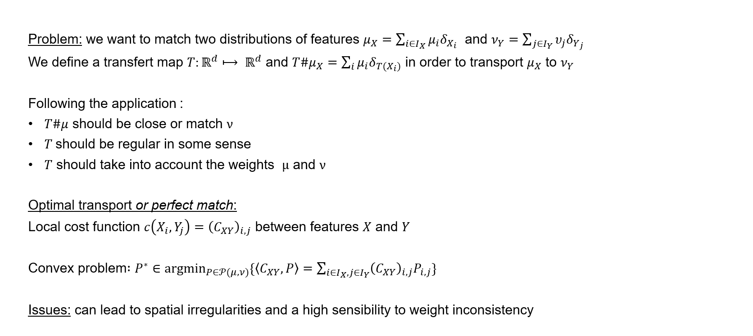
2.1 Problem formulation

Slide 9
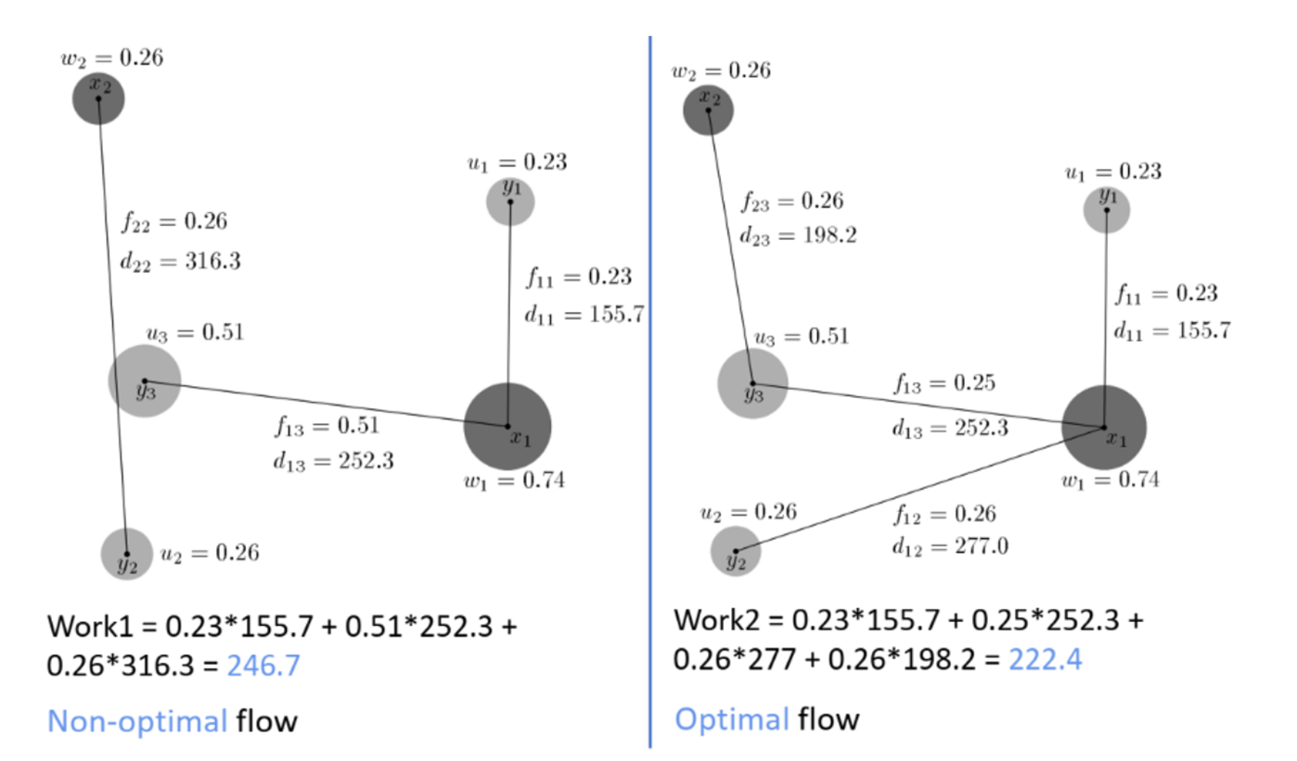
EMD

Slide 10
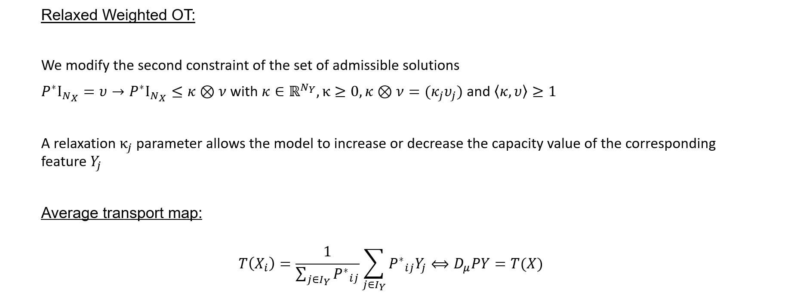
2.2 Tackle the issues

Slide 11
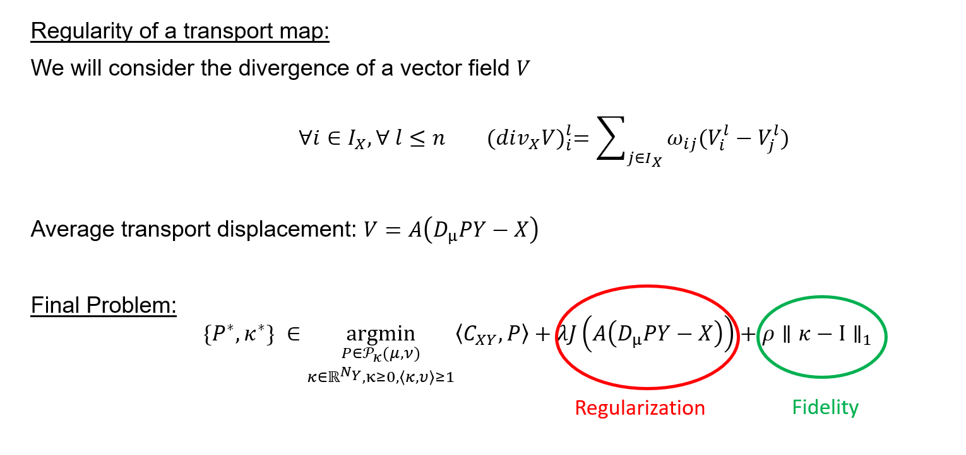
2.3 Final formulation

Slide 12
III- APPLICATION TO
COLOR TRANSFER

Slide 13
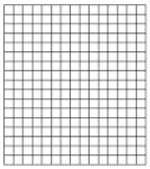
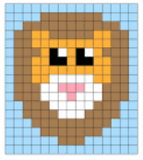
3.1 Framework
u : →
Ω_{u} ⊂ 𝕫² Σ_{u} ⊂ ℝ³
Modelisation of an image as an application
Steps to apply the previously presented framework to color transfer :
Define the source and target sets of features X and Y by spatio-color clustering on the input images u and v
Build a weighted graph from this clustering and define a transport cost matrix C_{XY}
Apply the estimated relaxed and regularized transport map on the image u
(Bonus : post-processing : apply a filter to restore the sharp details)
Notes:
The problem is to find a new image w whose geometry is as close as possible to the source image u and whose color distribution is close to the one of the exemplar image v.
Ω_{u} : regular pixel grid | Σ_{u} : quantized RGB color space

Slide 14
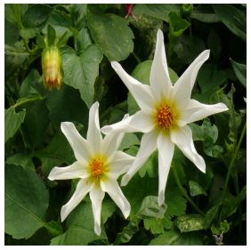
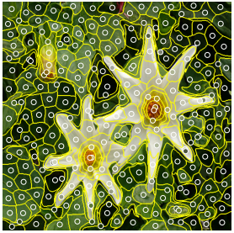
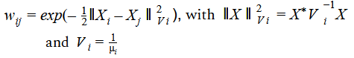
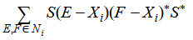

3.2 Spatio-color clustering
a)
Spatio-color
clustering
Concretely what is X ?
u → X
X = (X_{i})_{i∊⟦1;N_X⟧}
N_{X} : n° of clusters for u
X_{i} : centroid of the i^{th} cluster
image
set of features
X_{i} ∊ ℝ⁵, X_{i} = (i, j, r, g, b) = (x_{i}, U_{i})
spatial components x_{i}
color components U_{i}
How to get those clusters ? → Fast super-pixels method
|N_{i}|
number of pixels assigned to the cluster i
Cluster weight : μ_{i} =
=
|Ω_{u}|
number of pixels in the image
b)
Build a weighted graph of the clusters’ centroid (X_{i})
i) Compute a Nearest Neighbor graph (k-NN search)
ii) then assign the weight w_{ij} of the edge that links X_{i} to X_{j} as follows :
NB : we will talk about its use in the next slide
Notes:
The key element of our approach is the change of the image representation space in which we compute the transportation cost and the transportation map.
Unlike more basic approaches where we would directly apply the rgb histogram of the image, which serves as a "color palette", to the original image or where we would transport the colors pixel by pixel from image 2 to image 1, here we place ourselves in the space of super pixels by reasoning about pixel regions rather for the color transfer.
Joint clustering on the pixel grid and the color space (d = 5) to avoid dimensional issues.
X_{i} : centroid of the cluster i, represents the mean spatial and color values of the set of pixels in u assigned to cluster i
Each cluster can have a =/= amount of pixels N_{i} → cluster weight : μi = |N_{i}|/|Ω_{u}| = number of pixels assigned to the clusters / number of pixels in the image
Then we build a weighted graph of the clusters’ centroid :
i) a Nearest Neighbor graph is computed through k-NN search based on the L2 distance between clusters’centroid
ii) then we assign the weight wij of the edge that links Xi to Xj as follows : wij = exp(-½||Xi-Xj||**2) with the following norm : ||X||V = X*V-1X
the weighted empirical covariance matrix of cluster Xi, using diagonal weighting matrix S = diag (σx, σy , σr , σg , σb). Note that, the matrix V −1 i is in practice a pseudo-inverse matrix (Moore-Penrose) to avoid numerical problem when dealing with uniform clusters.

Slide 15
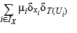

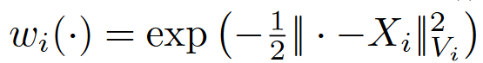
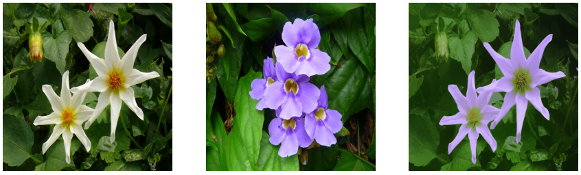
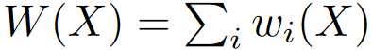
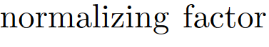
3.3 Color Palette Transfer & Image Synthesis
c)
Define the color palette transfer function :
T (U) = D_{μ} P* V , i.e. T # μ(x,U) =
P* : relaxed optimal transport matrix, solution of the optimization problem (mentioned slide 9)
with the following transport cost matrix : (C_{XY} )_{i,j} = ||U_{i} − V_{j} ||²
Final image synthesis :
W
T
(here comes to use the weighted graph)
+
=
geometry
color distribution
result
Notes:
Once we have the weighted graph and that the optimization problem is solve (mentioned earlier) to find the relaxed optimal transport matrix P*, we define the color transfer function as follows : T(U) = D_muP*V, i.e. T#mu(x,U) = sum(...)
Then, we finally compute the final resulting image of the color transfer.
For each pixel of the source image, once we have the weighted graph and the “transfer color” function, the idea is to use the likelihood of all clusters {Xi}i through the weights {wi}i in order to compute a linear combination of the estimated transferred colors T(Ui).
sharpening edges with filter
(bonus about how to compute color transfer function T with the definition of the transport cost Cxy)

Slide 16
IV- EXPERIMENTS

Slide 17
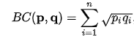
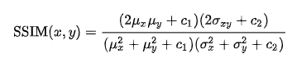
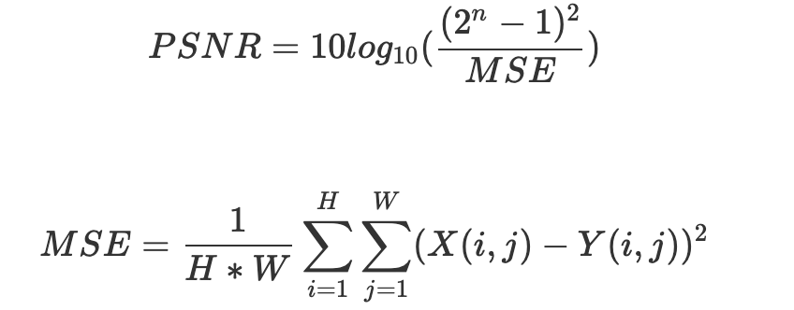
4.1 Metrics
Bhatacharya coefficient
SSIM
PSNR
Notes:
measurement of the amount of overlap between two statistical samples

Slide 18
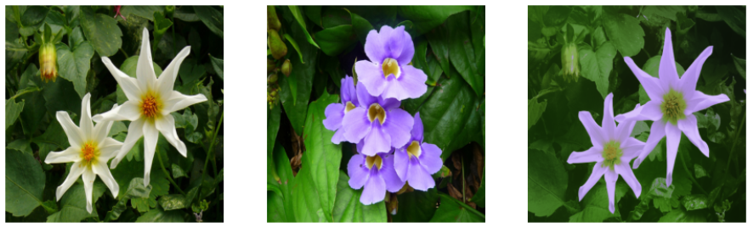
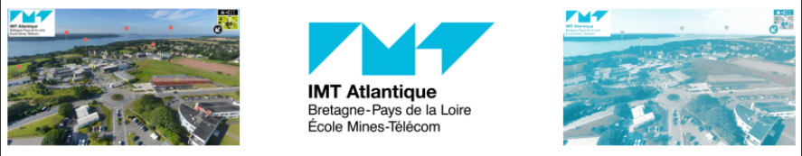
4.1 Metrics
Bhatacharya coefficient | 0.96
SSIM | 0.91
PSNR | 21,20
Bhatacharya coefficient | 0.66
SSIM | 0.80
PSNR | 10.42

Slide 19
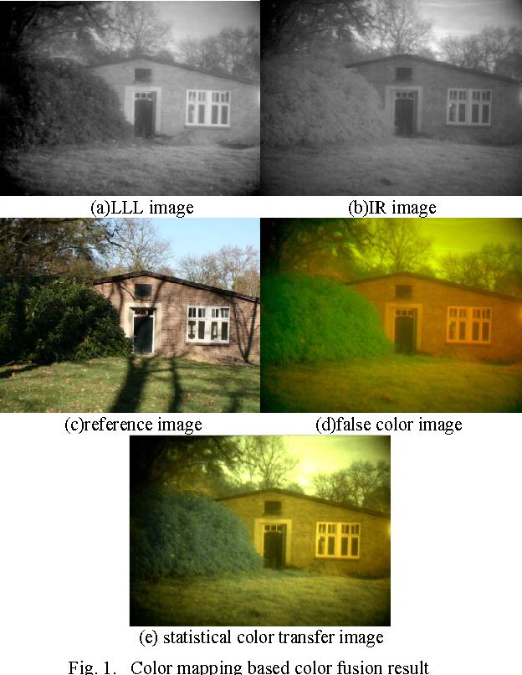
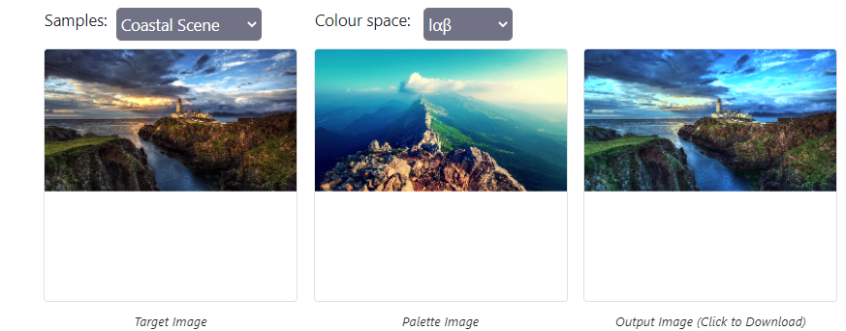
4.2 Applications

Slide 20
Thank you for listening !
If you have any question feel free to ask
Paper :
Julien Rabin, Sira Ferradans, Nicolas Papadakis.
Adaptive Color Transfer With Relaxed Optimal Transport.
IEEE international Conference on Image Processing (ICIP’14), Oct 2014, Paris, France. pp.4852-4856. hal-01002830
https://hal.archives-ouvertes.fr/hal-01002830/document
Notes:
2 - Christopher
3 - Antoine
4 Achraf

Slide 21

4.2 In case of a richer palette

